Slide 1
Stock Market Performance & Trend Analytics
Prepared by
Nikunj Ukey

Slide 2
Project Overview
End-to-end stock market analytics solution.
Combines Snowflake, Python, and Power BI.
Designed for decision-makers to evaluate performance and trends.

Slide 3
Business Problem Statement
Market data is large, fragmented, and hard to interpret.
Stakeholders need quick performance indicators.
Manual analysis delays business decisions.
Requirement: unified, reliable analytics system.

Slide 4
Analytical Objectives
Measure company and sector-level performance.
Identify trends (Uptrend / Downtrend).
Compare returns, prices, and volumes.
Enable filter-driven exploration.

Slide 5
Snowflake – Data Engineering Layer
Acts as centralized cloud data warehouse.
Stores cleaned stock price, fundamentals, and index data.
Handles large volumes efficiently.
Supports scalable analytics architecture.

Slide 6
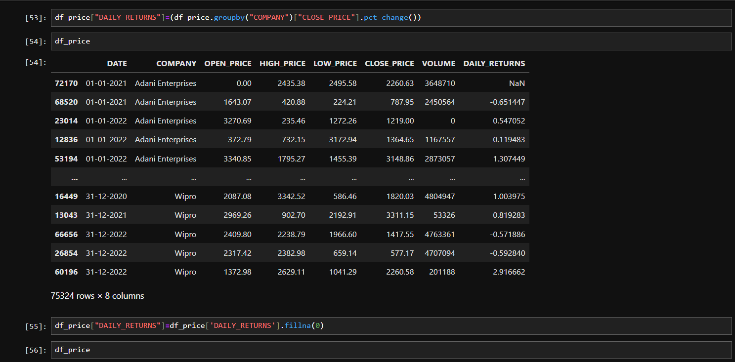
Python – Data Processing & Feature Engineering
Calculated Daily Returns using percentage change.
Created technical indicators like moving averages.
Handled missing values and data consistency.
Prepared analysis-ready datasets for BI

Slide 7
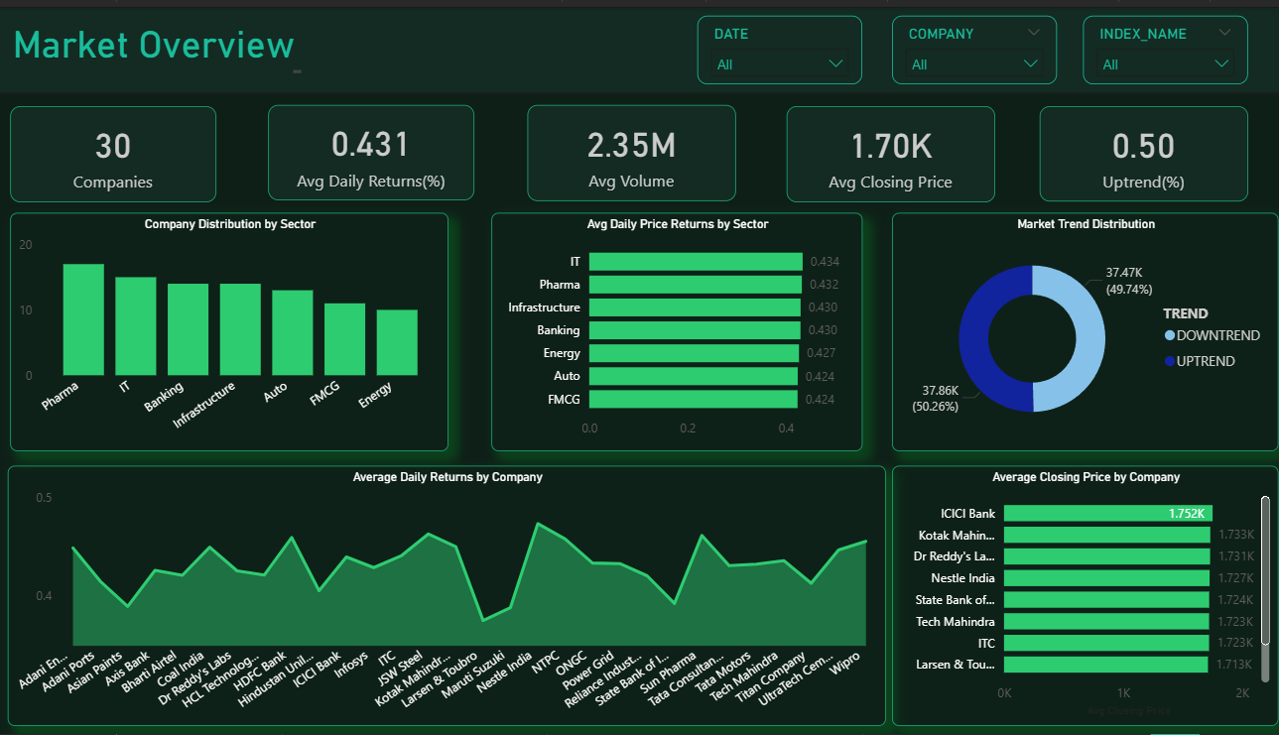
Power BI – Visualization & Reporting
Interactive dashboard with KPIs and filters.
Sector, company, and trend-level insights.
Green theme for positive market interpretation.
Enables fast executive decision-making.

Slide 8
Business Insights Delivered
Clear view of market-wide performance.
Identification of high-performing sectors.
Trend distribution between uptrend and downtrend.
Company-wise comparison for investment focus.

Slide 9
Overall Business Impact
Reduced analysis time significantly.
Improved data-driven decision culture.
Reusable analytics framework for future datasets.
Ready foundation for predictive modeling.

Slide 10
Future Scope & Enhancements
Machine learning for price forecasting and churn-like risk analysis.
Volatility and risk-adjusted return metrics.
Real-time data ingestion into Snowflake.
Automated alerts and advanced indicators.

